Slide 1
Programming Project #1
Forest Cover Presentation
Team Members :
Lalan Kumar Reddy Chinaganta
Mahender
Deekshith
Sai Dora Babu
Karthik Chatla
Harshad

Slide 2
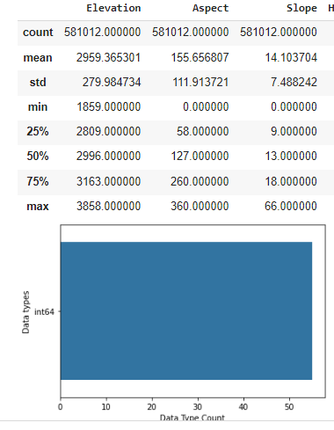
Data Visualization:
Data visualization is the graphical representation of information and data. By using visual elements like charts, graphs, and maps, data visualization tools provide an accessible way to see and understand trends, outliers, and patterns in data.
In the world of Big Data, data visualization tools and technologies are essential to analyze massive amounts of information and make data-driven decisions.

Slide 3
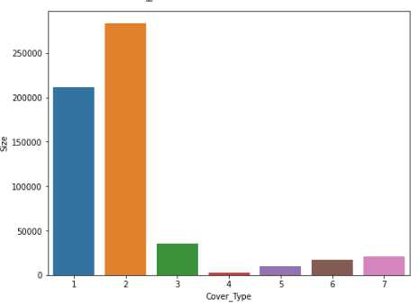
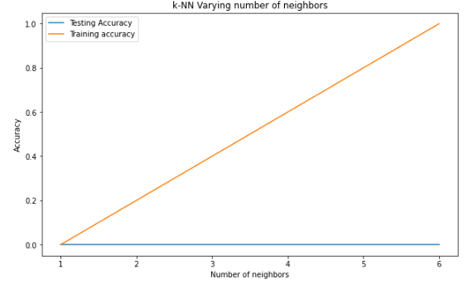
Forest Cover Data Visualization :
In this Forest Cover data visualization we are analyzing the entire data, training data, testing data, features and labels from the given data set covtype.
And also we are plotting the data in the form of bar graphs and Line graphs by importing the necessary dependencies.

Slide 4
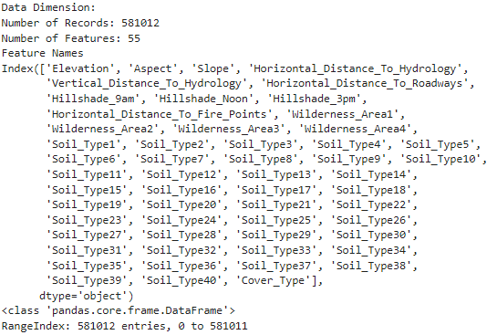
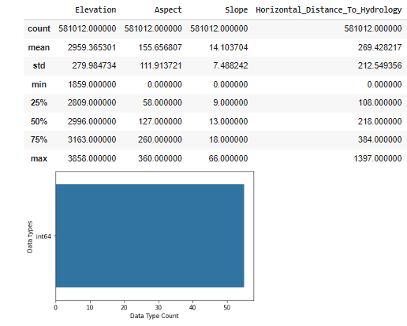
Reading Data From Analysis :
Here we are printing the data which includes the Dimensions, data Dimensions, Records, Features, Feature Names, Data type count and data types.

Slide 5
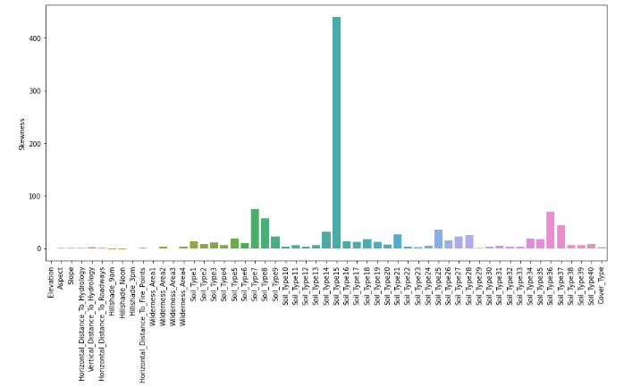
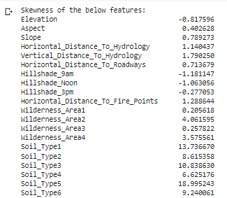
Skewness Data :
Here we are analyzing the Skewness data from the Features in a given data set Covtype as well as we are predicting the data in the form of graphs.

Slide 6
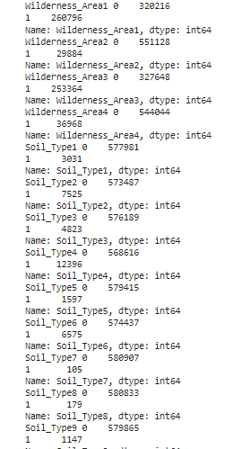
Predicting Data from Single Feature :
Here we are printing the data for single Feature data set(Soil Type1) and getting data in the form of Binary_data, Wilderness_data and soil_data. And also includes Elevations and Aspects of Soil Type.

Slide 7
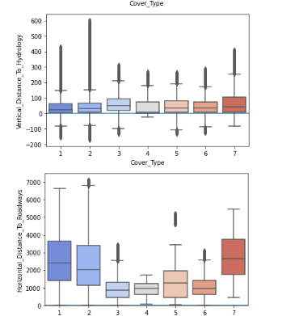
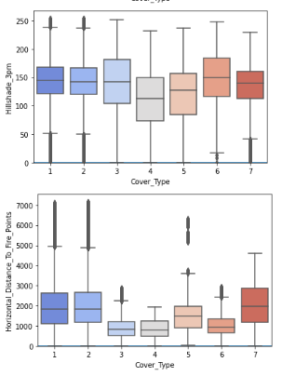

Slide 8
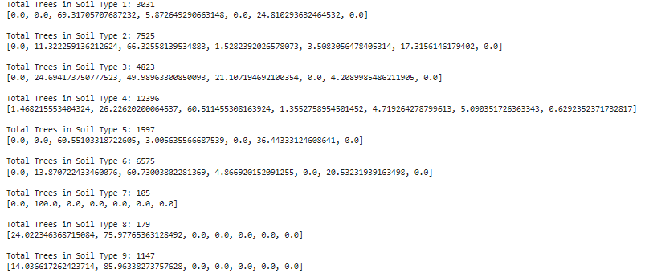
Total Tress in Soil Count :
Here we are printing Total tress in each soil type with the periodic table which includes Elevations, Aspects, Slopes, Horizontal distance to hydrology, Vertical distance to hydrology, Horizontal distance to Roadways, Hill shades and Horizontal distance to fire Points.

Slide 9
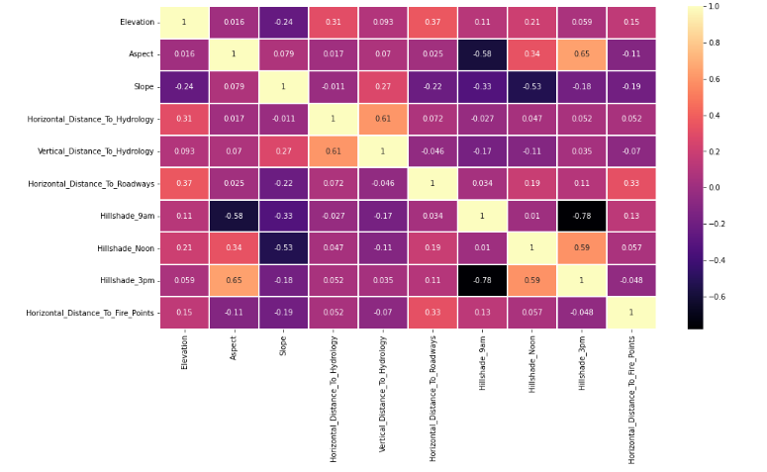

Slide 10
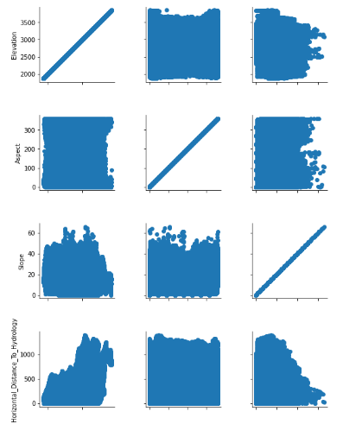
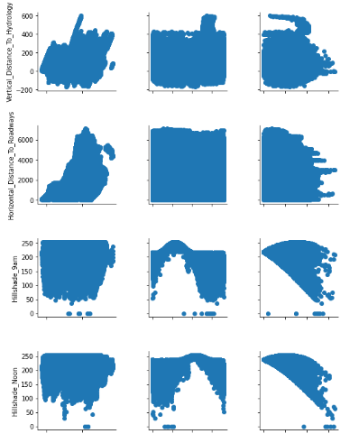

Slide 11
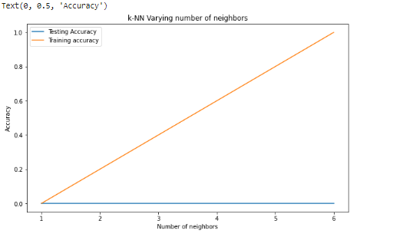
Generating Plot :
Finally we are plotting the K-NN varying number of neighbors along with the Testing accuracy and Training accuracy in the form of Line Graph. As well as we are calculating the Accuracy.

